Slide 1

Fourth UN Global
Road Safety Week

Slide 2
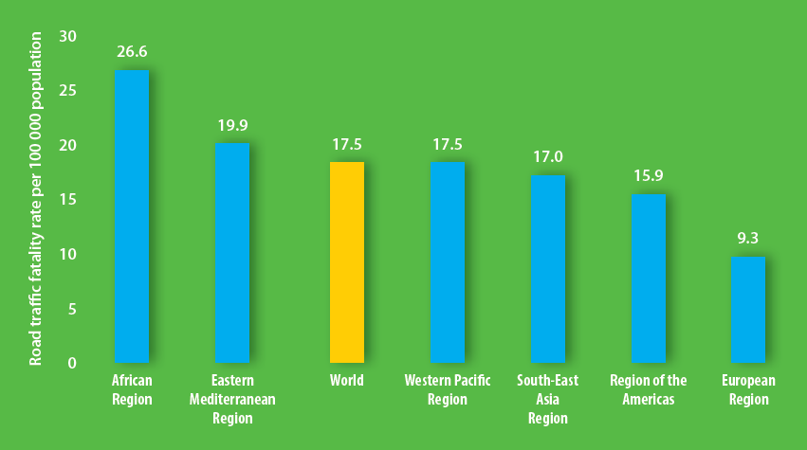
Road traffic injuries: the facts
Road traffic crashes kill 1.25 million people every year
90% of road traffic deaths occur in low- and middle-income countries
Road traffic injuries are the #1 cause of death for people aged 15-29 years
Road traffic crashes cost countries around 3% of their GDP
The risk of dying in a road traffic crash is lowest in Europe and highest in Africa

Slide 3
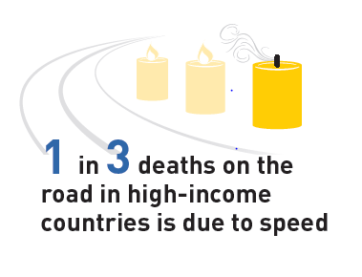
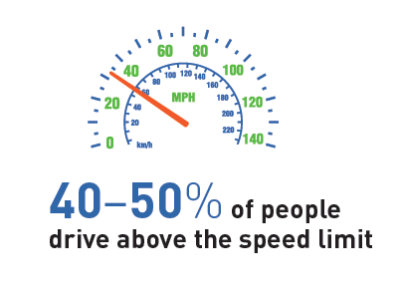
Speed is at the core of the road traffic injury problem

Slide 4
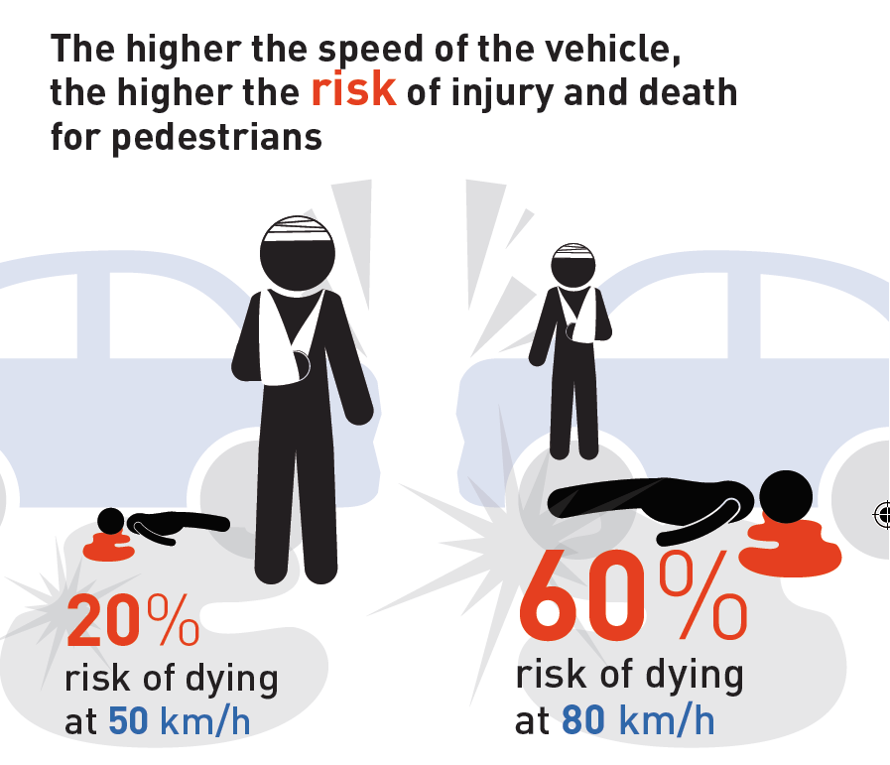
Speed is at the core of the road traffic injury problem

Slide 5
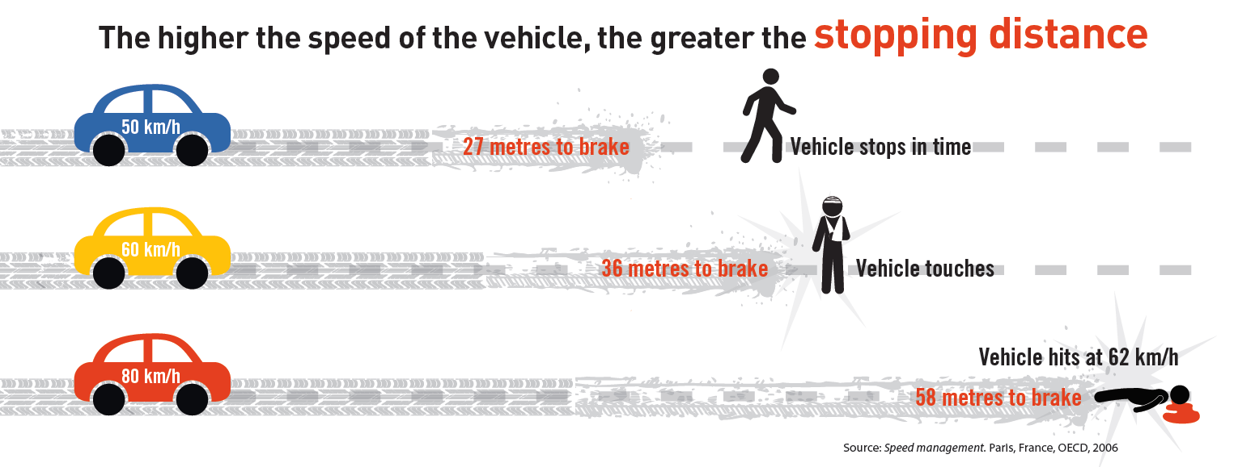
Speed is at the core of the road traffic injury problem

Slide 6
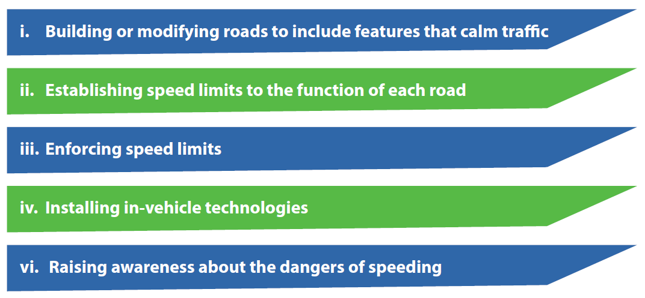
Approaches to managing speed

Slide 7
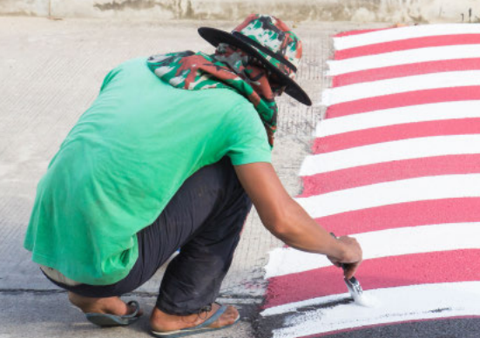
Speed management measures should be reflected in road design or redesign.
Features that can be constructed together as part of a traffic calming scheme include:
Roundabouts
Speed bumps
Chicanes
Rumble strips

Slide 8
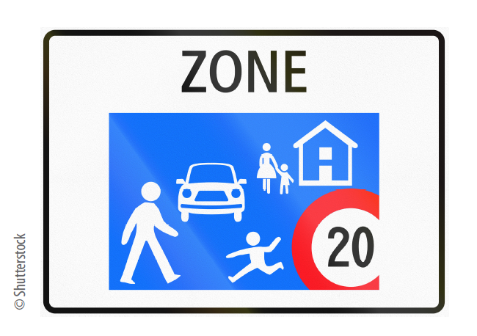
Setting speed limits appropriate to the function of each road is an important step in reducing speed.
Things to consider when setting the speed limit of the road include:
the road function;
the type and mix of road users;
the safety quality of the road infrastructure; and
the crashworthiness and crash avoidance capabilities of vehicle fleets.

Slide 9
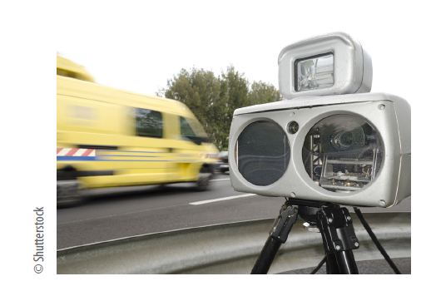
Enforcement is essential to make speed limits effective.
Manual speed control:
  Stationary observation units equipped with speed measurement devices
Automated speed control:
  Fixed cameras
  Mobile cameras
Appropriate fines to act as a deterrent

Slide 10
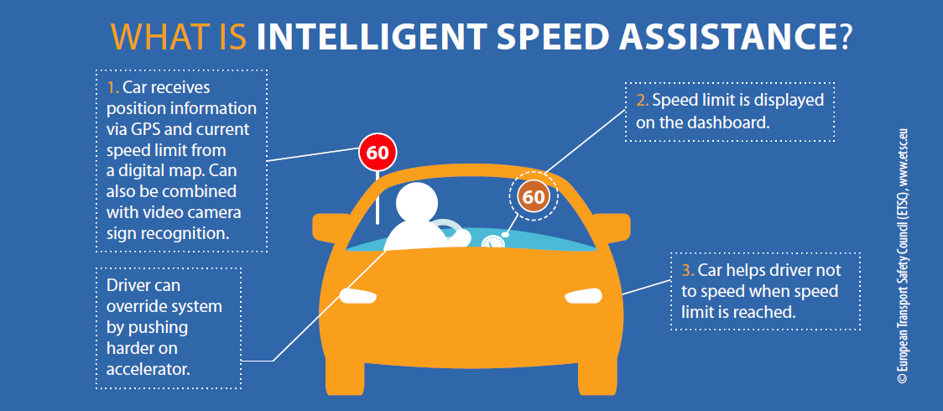
Vehicle safety technologies can greatly help improve safety on the road.
Intelligent speed assistance (ISA)
Autonomous emergency braking (AEB) – city, inter-urban and pedestrian.

Slide 11
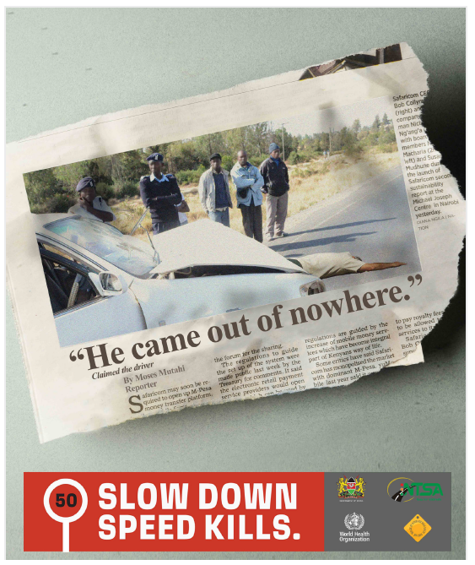
Mass media campaigns linked to the other approaches to speed management:
raise awareness about the dangers of speeding
gain greater public support for new legislation, stricter enforcement and stronger penalties

Slide 12
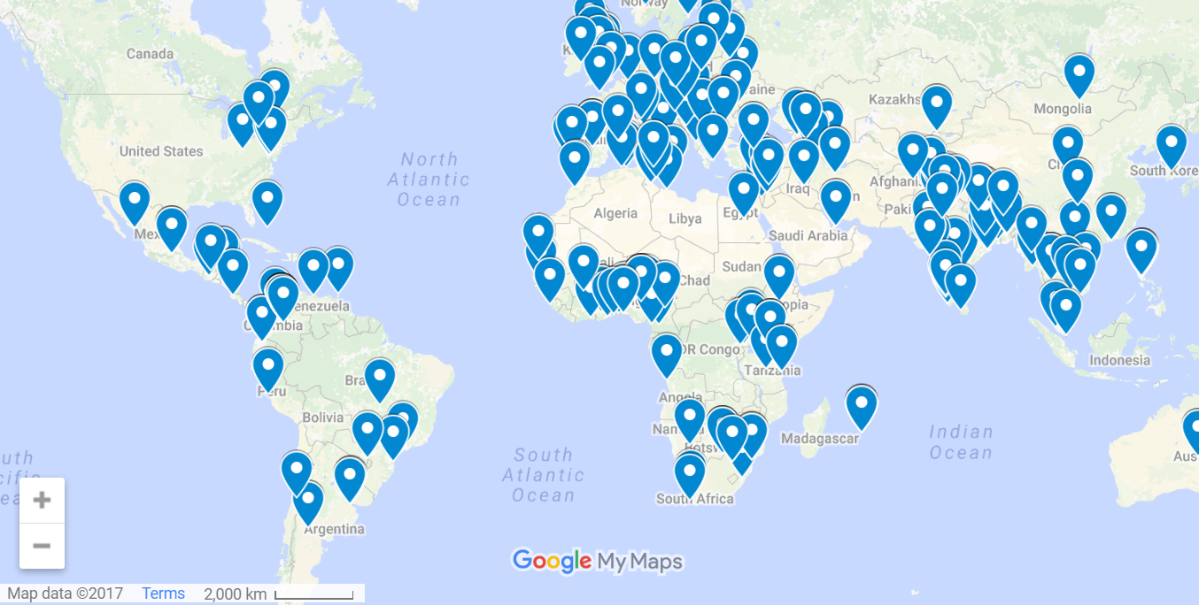
Fourth UN Global Road Safety Week: registered events
More than 300 events are registered events in more than 100 countries.

Slide 13
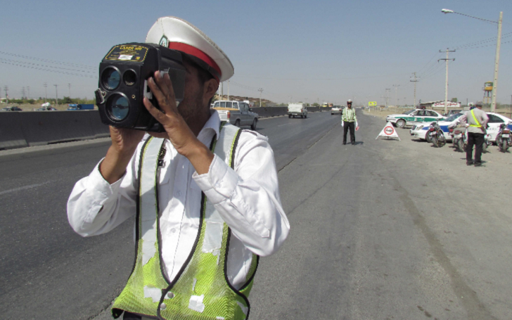
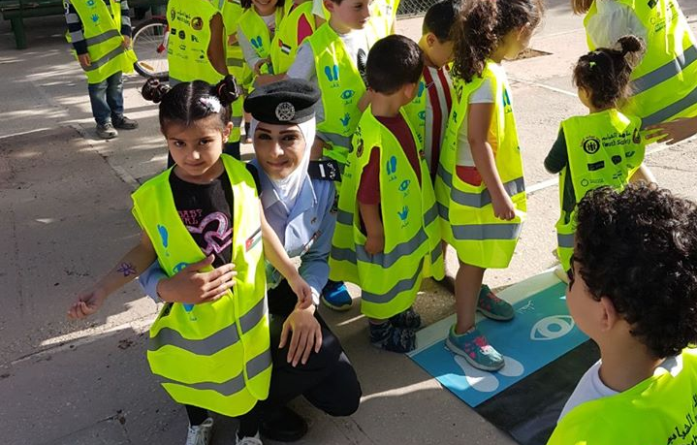
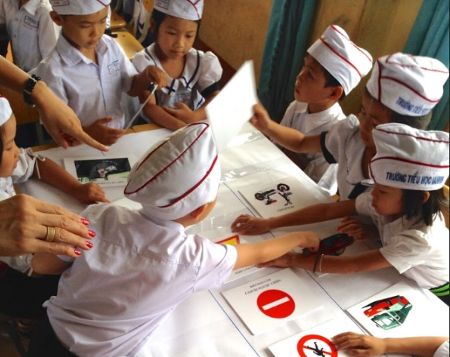
Fourth UN Global Road Safety Week: select events
Examples, among others,
  Slow Down Days: Belarus, Belgium, Benin, Botswana, Colombia, India, Malaysia, Nepal, Qatar, Spain, Trinidad and Tobago, Tunisia, Viet Nam
  Campaigns around schools: Brazil, Cameroon, China, Fiji, Gambia, Jordan, Morocco, Romania, South Africa, Uganda

Slide 14
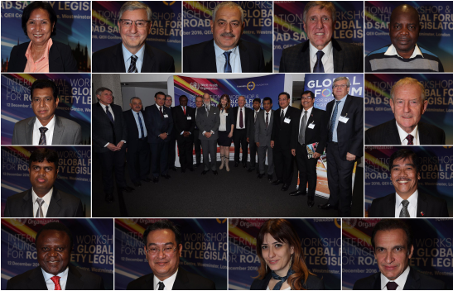
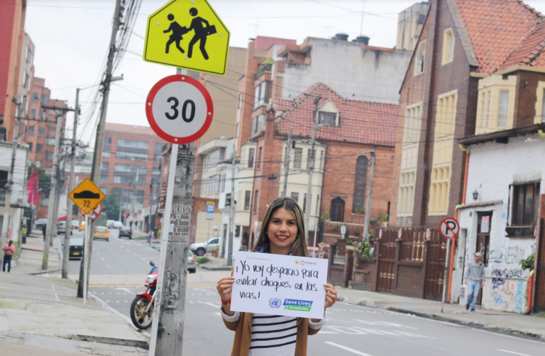
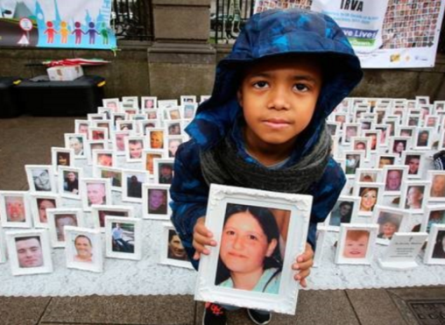
Fourth UN Global Road Safety Week: select events
  Activities with Parliamentarians: Armenia, Australia, Moldova, Myanmar, Thailand, Ukraine, United Kingdom
  Symposia: Montenegro, Nigeria, Philippines, Poland, Sierra Leone
  Vigils for road traffic victim: Ireland, Mauritius

Slide 15
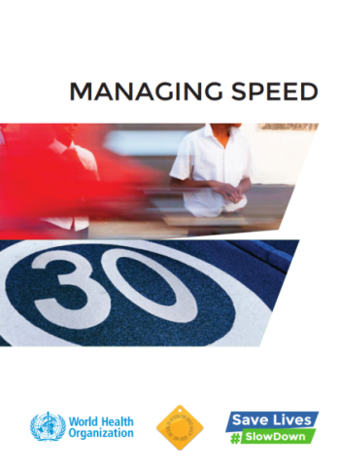
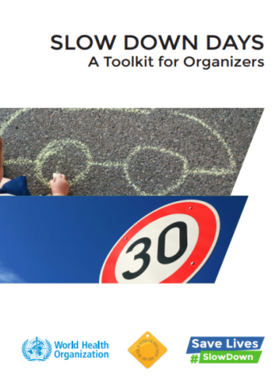


Resources
  WHO materials:
  http://www.who.int/roadsafety/week/2017/en/
  Managing speed
  Managing speed infographic
  Slow Down Days: a toolkit for organizers
  UN global road safety week web site:
    https://www.unroadsafetyweek.org
    Solutions: safe people, safe vehicles, safe roads
    Global calendar of events
    Logos/slogans and signboards
    Stories and news
  WHO Save LIVES package:
  http://www.who.int/violence_injury_prevention/road_traffic/en/

Slide 16
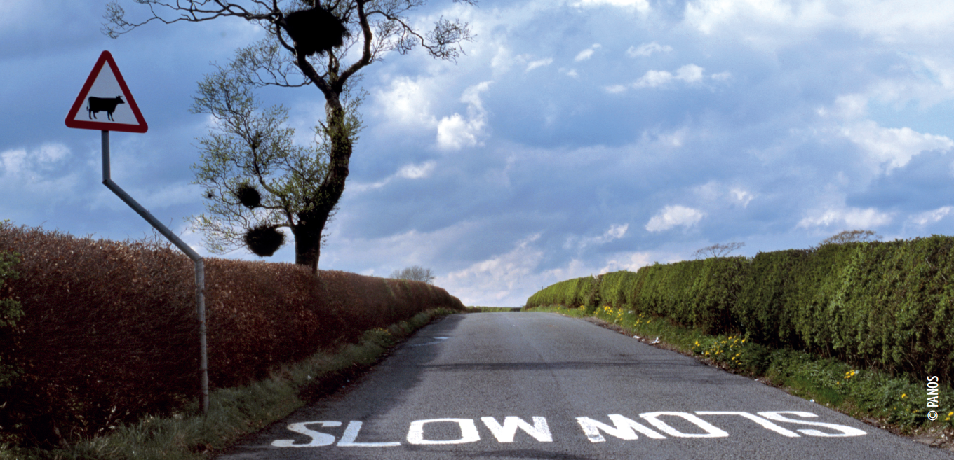
Thank you

